Slide 1
Machine Learning Algorithms
Master’s in Applied Artificial Intelligence
Luís Ferreira
lufer@ipca.pt

Slide 2
Overview
Part I
Artificial Intelligence and Machine Learning
Foundations<
Part II
Machine Learning
Part III
Machine Learning Algorithms (I)
Parte IV
Machine Learning Algorithms (Adv.)
Parte V
Deep Learning & Neural Networks

Slide 3
Part I
Artificial Intelligence & Machine Learning Foundations
Competencies to be acquired:
Concepts understanding
Context perception
Knowledge demonstration

Slide 4
Part I - AI&ML
Foundations
Concepts Understanding
Artificial
Intelligence
Learning
Flexibility and Analytics

Slide 5
Part I - AI&ML – Foundations
Concepts Understanding
Artificial
  Artificial means do not occur naturally and are created by someone or something …is it required to have science and technology involved?
  Made by human (for now)
  Simulate or substitute something natural, required or expected!
  Intended

Slide 6
Part I - AI&ML – Foundations
Concepts Understanding
Intelligence (according to Psychologists)
Ability to learn, recognize problems, and then solve them
  Learning requires us to take information in and hold it in our memory.
  Recognizing problems needs us to be able to separate what’s working and not working.
  Solving problems deals with our ability to fix what we’ve identified to not work

Slide 7
Part I - AI&ML – Foundations
Concepts Understanding
Intelligence
”…The ability to learn or understand or to deal with new or trying situations:”
“…The ability to apply knowledge to manipulate one’s environment or to think abstractly as measured by objective criteria...”
Merriam-Webster Dictionary
Notes:
“…The ability to apply knowledge to manipulate one’s environment or to think abstractly as measured by objective criteria (such as an experience or test)..”

Slide 8
Part I - AI&ML – Foundations
Concepts Understanding
Intelligence
Mental acuteness: SHREWDNESS
The act of understanding: COMPREHENSION
The ability to perform computer functions : (NONSENSE!?)
Learning
Notes:
Acuidade mental: perspicácia
O ato de compreender: COMPREENSÃO

Slide 9
Part I - AI&ML – Foundations
Concepts Understanding
Learning
“…Learning is any process by which a system improves performance from experience…” (Herbert Simon)
“…Learning denotes changes in a system that enables it to the same task more efficiently the next time…” (Herbert Simon)
“…Learning is making useful changes in our minds…” (Marvin Minsky)

Slide 10
Part I - AI&ML – Foundations
Concepts Understanding
Learning
A computer program is said to learn if it:
  improves its performance P
  at some task T
  with experience E. (See Chapter 1, page 3 of “Machine Learning” – Tom Mitchel, 1997)
<P,T,E>

Slide 11
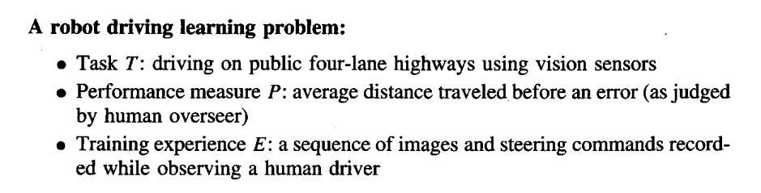
Part I - AI&ML – Foundations
Concepts Understanding
Learning
A computer program is said to learn if it:
  improves their performance P
  at some task T
  with experience E. (See Chapter 1, page 3 of “Machine Learning” – Tom M. Mitchel, 1997)
<P,T,E>

Slide 12
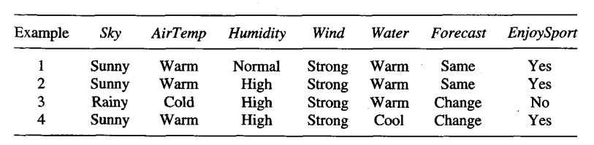
Part I - AI&ML – Foundations
Concepts Understanding
Learning
Concept Learning:
  Inferring a boolean-valued function from training examples of its input and output.
Positive and negative training examples for the target concept EnjoySport.
(Tom M. Mitchel, 1997)
Notes:
The attribute EnjoySport indicates whether or not Aldo enjoys his favourite water sport on this day.
The task is to learn to predict the value of EnjoySport for an arbitrary day, based on the values of its other attributes.

Slide 13
Part I - AI&ML – Foundations
Concepts Understanding
Learning
Concept Learning:
  Inferring a boolean-valued function from training examples of its input and output.
T: predict the value of EnjoySport for an arbitrary day
X: (Sky, AirTemp, Humidity, Wind, Water, Forecast)
Target concept: c: EnjoySport : X → (0|1)
Hypotheses: h(x) = c(x) for all x in X
(Tom M. Mitchel, 1997)
Notes:
The attribute EnjoySport indicates whether or not Aldo enjoys his favourite water sport on this day.
The task is to learn to predict the value of EnjoySport for an arbitrary day, based on the values of its other attributes.

Slide 14
Part I - AI&ML – Foundations
Concepts Understanding
Flexibility
“…the ability to remove bias from your own viewpoint and take in different viewpoints is a fundamental part of being intelligent…”
Human biases: Confirmation bias, Clustering bias, and Bandwagon effect
  Confirmation bias is where you stick to your own beliefs despite being presented with different evidence;
  Clustering bias is when we look for patterns in random data.
  Bandwagon effect, or groupthink, is the rut of thinking in which we go with what everyone else believes or says.
Intelligence: A Different Perspective - Dylan Norman, Athenas Academy, 2020
Notes:
Bias - Preconceitos

Slide 15
Part I - AI&ML – Foundations
Concepts Understanding
Analytics
“…An ability to not just consider, but analyse, without any bias, different viewpoints, information, and arguments is critical to being intelligent…”
Understanding is simply to learn how something works. Analysing is to examine and question how something works.
Analysis is also essential when talking about grey areas…Sometimes the right answer simply isn’t perfect. More often still, the right answer isn’t clearly right
Intelligence: A Different Perspective - Dylan Norman, Athenas Academy, 2020
Notes:
Bias - Preconceitos

Slide 16
Part I - AI&ML
Foundations
Context perception
Artificial Intelligence
Machine Learning
Deep Learning

Slide 17
Part I - AI&ML – Foundations
Context Perception
Artificial Intelligence (John McCarthy)
“…Artificial Intelligence (AI) refers to the development of computer systems that can perform tasks that typically require human intelligence. These tasks include learning, reasoning, problem-solving, perception, speech recognition, and language understanding. The goal of AI is to create machines that can simulate human intelligence and perform tasks efficiently, sometimes even surpassing human capabilities…”
ChatGPT, 2024
Notes:
Bias - Preconceitos

Slide 18
Part I - AI&ML – Foundations
Context Perception
Artificial Intelligence
“...the capability of computer systems or algorithms to imitate intelligent human behaviour…”
“…leverages computers and machines to mimic the problem-solving and decision-making capabilities of the human mind…”
Term used to describe the ability of a machine to perform cognitive processes!
Merriam-Webster Dictionary
IBM
Web
Notes:
https://www.mygreatlearning.com/blog/what-is-artificial-intelligence/
Artificial Narrow Intelligence (ANI)
Artificial General Intelligence (AGI)
Artificial Super Intelligence (ASI)

Slide 19
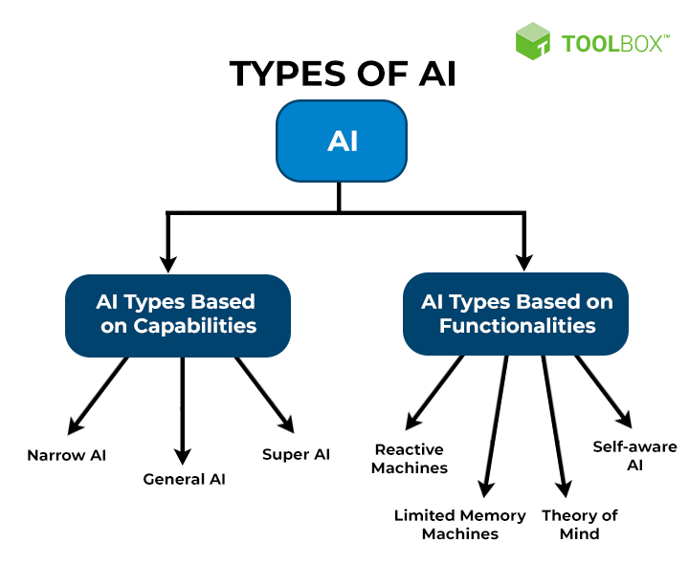
Part I - AI&ML – Foundations
Context Perception
Artificial Intelligence
Notes:
https://www.mygreatlearning.com/blog/what-is-artificial-intelligence/
Artificial Narrow Intelligence (ANI)
Artificial General Intelligence (AGI)
Artificial Super Intelligence (ASI)

Slide 20
Part I - AI&ML – Foundations
Context Perception
Artificial Intelligence
Narrow or Weak AI (ANI)
  “…to perform a specific task or a narrow range of tasks. Examples include virtual personal assistants (like Siri or Alexa), image recognition software, and recommendation systems. Narrow AI excels in its specific domain but lacks the general cognitive abilities associated with human intelligence …”
  General or Strong AI: (AGI | ASI)
  “…type of artificial intelligence that can understand, learn, and apply knowledge across diverse tasks, similar to human intelligence. Achieving strong AI is a more complex and long-term goal, and currently, the focus is primarily on developing narrow AI for specific applications…”
  ChatGPT, 2024
Notes:
https://www.mygreatlearning.com/blog/what-is-artificial-intelligence/
Artificial Narrow Intelligence (ANI)
Artificial General Intelligence (AGI)
Artificial Super Intelligence (ASI)

Slide 21
Part I - AI&ML – Foundations
Context Perception
Artificial Intelligence
Reactive Machines
  “…basic AI types that do not store past experiences or memories for future actions…”
  Limited memory machines
  “…can store and use past experiences or data for a short period of time…”
Theory of mind (for future!)
  “…type of AI that can understand human emotions and beliefs and socially interact like humans…”
Self-aware AI (for future!)
  “…deals with super-intelligent machines with their consciousness, sentiments, emotions, and beliefs…”
  SpiceWotrks, 2024
Notes:
https://www.mygreatlearning.com/blog/what-is-artificial-intelligence/
Artificial Narrow Intelligence (ANI)
Artificial General Intelligence (AGI)
Artificial Super Intelligence (ASI)

Slide 22
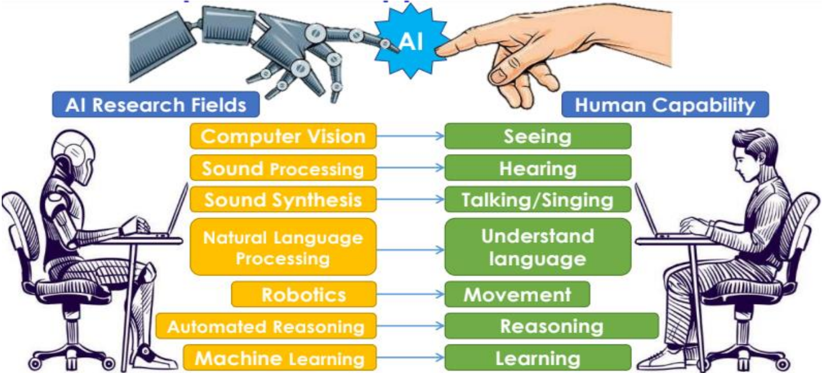
Part I - AI&ML – Foundations
Context Perception
Goals of Artificial Intelligence
SpiceWotrks, 2024
Notes:
https://www.mygreatlearning.com/blog/what-is-artificial-intelligence/
Artificial Narrow Intelligence (ANI)
Artificial General Intelligence (AGI)
Artificial Super Intelligence (ASI)

Slide 23
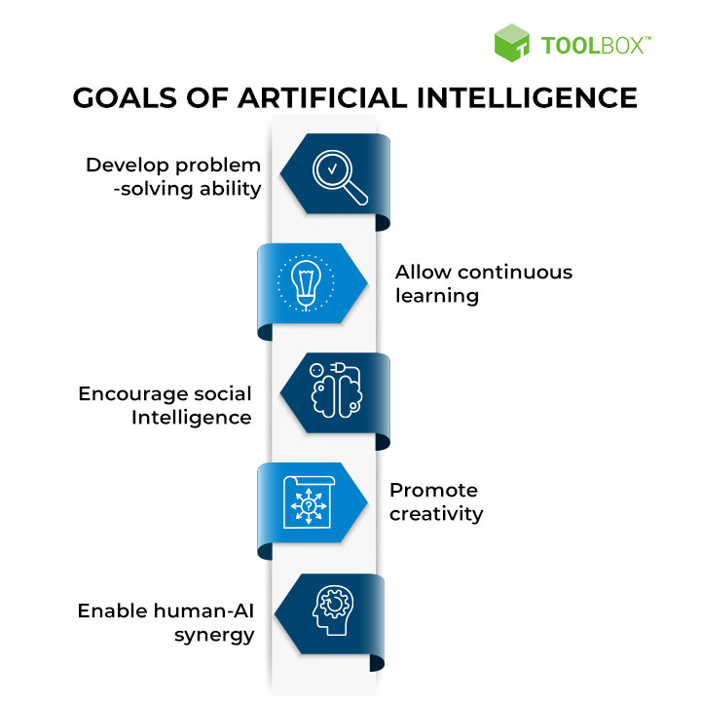
Part I - AI&ML – Foundations
Context Perception
Goals of Artificial Intelligence
SpiceWotrks, 2024
Notes:
https://www.spiceworks.com/tech/artificial-intelligence/articles/what-is-ai/#_004

Slide 24
Part I - AI&ML – Foundations
Context Perception
Machine Learning (Geoffrey Everest Hinton)
Field of study that gives computers the ability to learn without being explicitly programmed! Arthur Samuel( 1959)
  “…a subset of AI that uses algorithms to identify patterns within data, and those patterns are then used to create a data model that can make predictions…”
  “…with increased data and experience, the results of machine learning are more accurate—much like how humans improve with more practice…”
  Microsoft
Notes:
https://www.mygreatlearning.com/blog/what-is-artificial-intelligence/
Artificial Narrow Intelligence (ANI)
Artificial General Intelligence (AGI)
Artificial Super Intelligence (ASI)

Slide 25
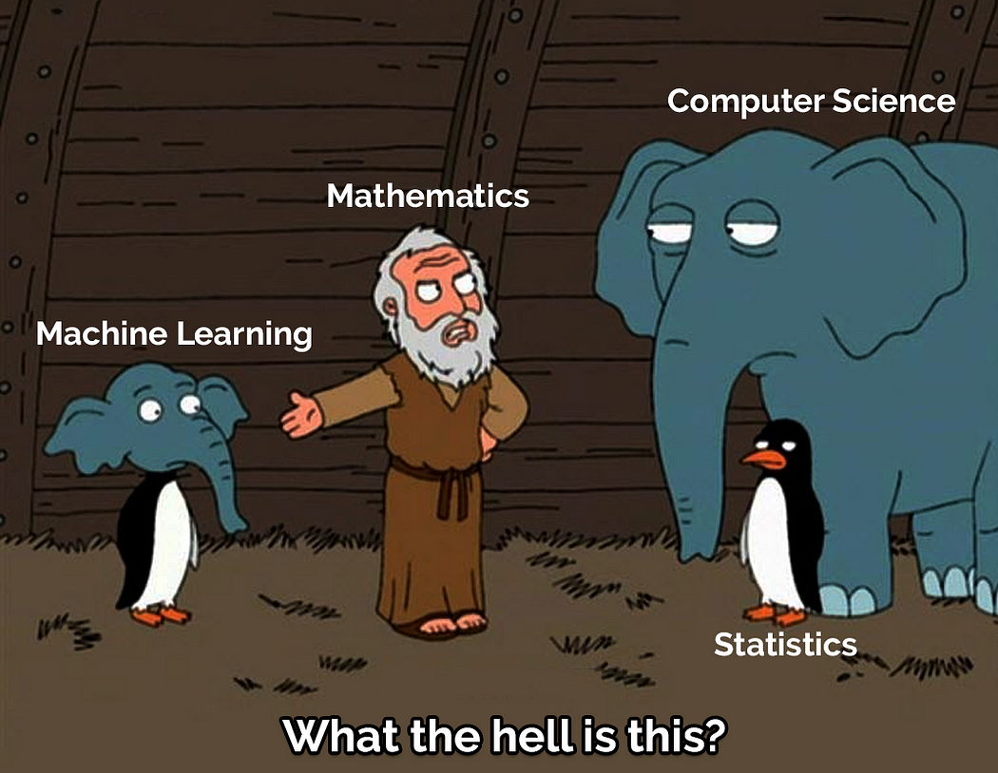
Part I - AI&ML – Foundations
Context Perception
Machine Learning
Field of study that gives computers the ability to learn without being explicitly programmed! Arthur Samuel( 1959)
  “…a subset of AI that uses algorithms to identify patterns within data, and those patterns are then used to create a data model that can make predictions…”
  “…with increased data and experience, the results of machine learning are more accurate—much like how humans improve with more practice…”
  Microsoft
Notes:
https://www.mygreatlearning.com/blog/what-is-artificial-intelligence/
Artificial Narrow Intelligence (ANI)
Artificial General Intelligence (AGI)
Artificial Super Intelligence (ASI)

Slide 26
Part I - AI&ML – Foundations
Context Perception
Machine Learning
Field of study that gives computers the ability to learn without being explicitly programmed! Arthur Samuel( 1959)
  “…a subset of AI that uses algorithms to identify patterns within data, and those patterns are then used to create a data model that can make predictions…”
  “…with increased data and experience, the results of machine learning are more accurate—much like how humans improve with more practice…”
  Microsoft
Learning from data, making predictions or decisions, improving performance over time, and adapting to new information
Notes:
https://www.mygreatlearning.com/blog/what-is-artificial-intelligence/
Artificial Narrow Intelligence (ANI)
Artificial General Intelligence (AGI)
Artificial Super Intelligence (ASI)

Slide 27
Part I - AI&ML – Foundations
Context Perception
Types of Machine Learning:
Supervised Learning: Training a model on labelled data with input-output pairs.
Unsupervised Learning: Discovering patterns in unlabelled data.
Reinforcement Learning: Learning through interaction with an environment, receiving feedback in the form of rewards or penalties.
Notes:
https://www.mygreatlearning.com/blog/what-is-artificial-intelligence/
Artificial Narrow Intelligence (ANI)
Artificial General Intelligence (AGI)
Artificial Super Intelligence (ASI)

Slide 28
Part I - AI&ML – Foundations
Context Perception
Deep Learning (Bengio, Hinton and LeCun)
“…is a specific class of Machine Learning algorithms which are using complex neural networks. In a sense, it is a group of related techniques like the group of “decision trees” or “support vector machines”.
“…subfield of machine learning that involves neural networks with multiple layers (deep neural networks)…aims to automatically learn hierarchical representations of data…”
Notes:
https://www.mygreatlearning.com/blog/what-is-artificial-intelligence/
Artificial Narrow Intelligence (ANI)
Artificial General Intelligence (AGI)
Artificial Super Intelligence (ASI)

Slide 29
Part I - AI&ML – Foundations
Context Perception
Deep Learning:
“…is a specific class of Machine Learning algorithms which are using complex neural networks. In a sense, it is a group of related techniques like the group of “decision trees” or “support vector machines”.
“…subfield of machine learning that involves neural networks with multiple layers (deep neural networks)…aims to automatically learn hierarchical representations of data…”
Feature learning, abstraction, automatic feature extraction, and high-level representation learning
Notes:
https://www.mygreatlearning.com/blog/what-is-artificial-intelligence/
Artificial Narrow Intelligence (ANI)
Artificial General Intelligence (AGI)
Artificial Super Intelligence (ASI)

Slide 30
Part I - AI&ML – Foundations
Context Perception
Types of Deep Learning:
Convolutional Neural Networks (CNNs): Particularly effective for image and video analysis.
Recurrent Neural Networks (RNNs): Suited for sequential data, such as time series or natural language.
Generative Adversarial Networks (GANs): Used for generating new, realistic data
Notes:
https://www.mygreatlearning.com/blog/what-is-artificial-intelligence/
Artificial Narrow Intelligence (ANI)
Artificial General Intelligence (AGI)
Artificial Super Intelligence (ASI)

Slide 31
Part I - AI&ML – Foundations
Context Perception
Artificial Intelligence, Machine Learning & Deep Learning
Artificial Intelligence is the “umbrella” of all tentative to make computer and machines support cognitive capacities.
“…Machine Learning is the subset of Artificial Intelligence which deals with the extraction of patterns from data sets…”
  “…Deep learning is a specialized form of machine learning, using neural networks (NN) to deliver answers…”
  Microsoft
Notes:
https://www.mygreatlearning.com/blog/what-is-artificial-intelligence/
Artificial Narrow Intelligence (ANI)
Artificial General Intelligence (AGI)
Artificial Super Intelligence (ASI)

Slide 32
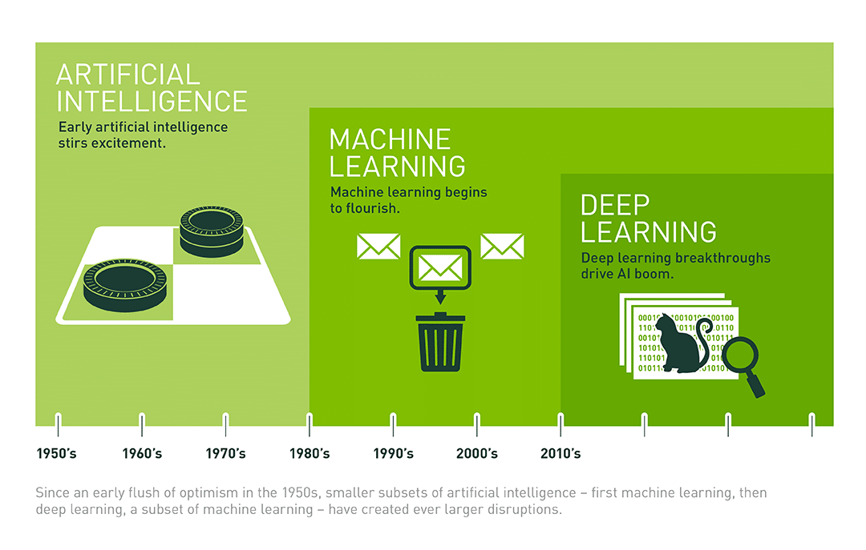
Part I - AI&ML – Foundations
Context Perception
Artificial Intelligence, Machine Learning & Deep Learning
“…Machine learning is considered a subset of AI. An “intelligent” computer thinks like a human and carries out tasks on its own…”
  “…Deep learning is a specialized form of machine learning, using neural networks (NN) to deliver answers…”
  Microsoft
NVIDIA, 2024
Notes:
https://www.mygreatlearning.com/blog/what-is-artificial-intelligence/
Artificial Narrow Intelligence (ANI)
Artificial General Intelligence (AGI)
Artificial Super Intelligence (ASI)

Slide 33
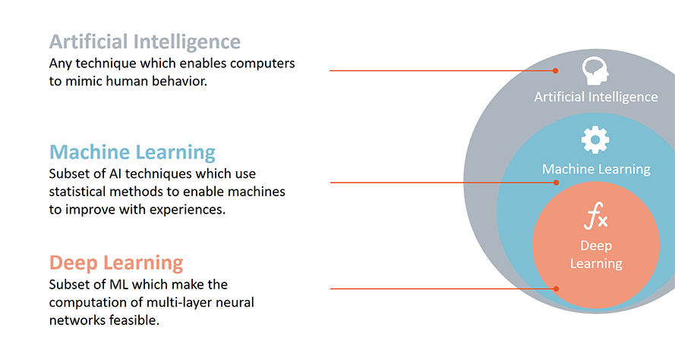
Part I - AI&ML – Foundations
Context Perception
Artificial Intelligence, Machine Learning & Deep Learning
“…Machine learning is considered a subset of AI. An “intelligent” computer thinks like a human and carries out tasks on its own…”
  “…Deep learning is a specialized form of machine learning, using neural networks (NN) to deliver answers…”
  Microsoft
NVIDIA, 2024
Notes:
https://www.mygreatlearning.com/blog/what-is-artificial-intelligence/
Artificial Narrow Intelligence (ANI)
Artificial General Intelligence (AGI)
Artificial Super Intelligence (ASI)

Slide 34
Part I - AI&ML – Foundations
Knowledge demonstration
Applications of AI & ML &DL
AI Examples
  Recommendation systems, Virtual Assistants, Chatbots, Language Translation, Fraud detection, Healthcare diagnostics, Gaming, etc.
Machine Learning Examples:
  Image Recognition, Natural Language Processing (NLP), Speech Recognition, Recommendation Systems, Anomaly Detection, Predictive Maintenance, Healthcare Diagnostics, Autonomous Vehicles, etc…
Deep Learning Examples:
  Image Classification, Object Detection, Facial Recognition, Semantic Segmentation, advanced features on ML processes
Notes:
https://www.analyticsvidhya.com/blog/2021/06/machine-learning-vs-artificial-intelligence-vs-deep-learning/

Slide 35
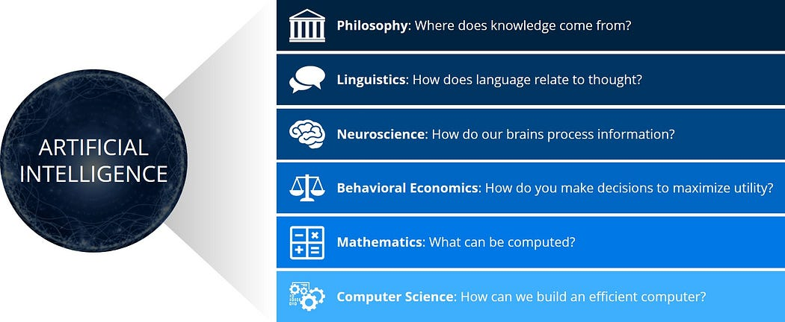
Part I - AI&ML:
Summary
Artificial Intelligence – A Modern Approach (2nd edition)
See https://www.mygreatlearning.com/blog/what-is-artificial-intelligence/

Slide 36
Part I - AI&ML:
Summary
Artificial Intelligence (AI) is the process of making computers smart.
An Algorithm is the process used to solve a problem.
Machine learning (ML) is a subset of AI that allows computers to learn for themselves, from data observation.
Deep Learning (DL) is a subset of ML that allows computers to learn more by themselves, from data that can be unlabelled and-- unstructured in layers

Slide 37
Part I - AI&ML:
Check
MIA Course Quiz – Part I
  https://docs.google.com/forms/d/e/1FAIpQLSdUWMjEh-w9Oa4pLhGEsThI_FKkgIqU7YaD0TqTiiYeVehmhw/viewform?usp=sharing
Artificial Intelligence Quiz (Test I):
  https://codescracker.com/exam/showtest.php?subid=28

Slide 38
References
Machine Learning. Tom M. Mitchel, McGraw-Hill, 1997
Artiﬁcial Intelligence, A Modern Approach Third Edition, Stuart J. Russell and Peter Norvig, Prentice Hall, 2010
Machine Learning Tutorial
  https://www.simplilearn.com/tutorials/machine-learning-tutorial/machine-learning-steps
More Material
  https://github.com/josephmisiti/awesome-machine-learning/blob/master/books.md

Slide 39
More readings
  The following sources can be useful throughout the course:
  Hastie, Tibshirani, and Friedman: The Elements of Statistical Learning
  Christopher Bishop: Pattern Recognition and Machine Learning, 2006.
  Kevin Murphy: Machine Learning: a Probabilistic Perspective, 2012.
  David Mackay: Information Theory, Inference, and Learning Algorithms, 2003.
  Shai Shalev-Shwartz & Shai Ben-David: Understanding Machine Learning: From Theory to Algorithms, 2014.
  David Barber: Bayesian Reasoning and Machine Learning, 2012.
  Richard S. Sutton and Andrew G. Barto: Reinforcement Learning: An Introduction (2nd ed.), 2018.

Slide 40
Progress
Part I
Artificial Intelligence and Machine Learning
Foundations
Part II
Machine Learning
Part III
Machine Learning Algorithms (I)
Part IV
Machine Learning Algorithms (II)
Part V
Deep Learning & Neural Networks

